Slide 1
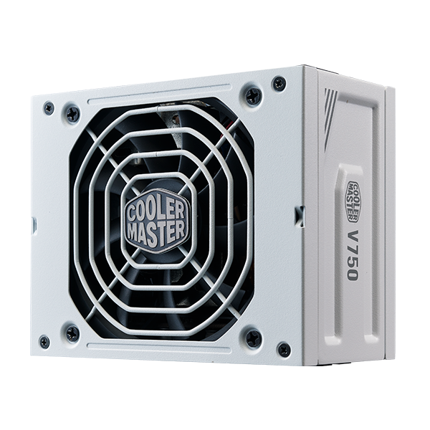
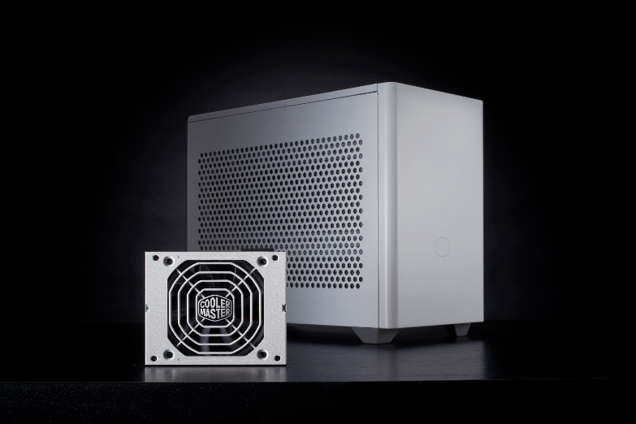
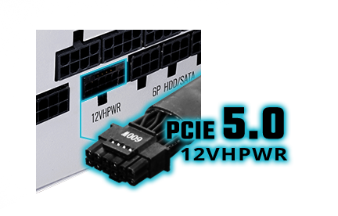
SMALL BUT MIGHTY
Welcome to the world of the V SFX Gold, a small but mighty PSU. The V SFX Gold has one of the highest power densities available today Additionally with an included ATX compatibility bracket, the V SFX Gold can support a PC of any size.
The V SFX Gold also features ATX 3.0 support, a durable 12VHPWR cable, 80 Plus Gold efficiency, fully modular cables, an FDB fan, 16AWG PCIe high-efficiency cables, and a 10-year warranty. Deliver compact, mighty power to your build with the V SFX Gold.
V SFX Gold 750 ATX 3.0 WHITE EDITION
Compact SFX form factor: The ultra-compact dimensions of this SFX unit make it the perfect fit for a mini-ITX build.
​
High power density: With 160% greater power density than the V Gold 750 V2, this is one of the highest power densities in the industry.
Flexible compatibility: An included bracket ensures compatibility with both ITX and ATX cases.
80 Plus Gold efficiency certification: This unit is certified to achieve more than 90% efficiency at typical loads.​
Quiet FDB fan: A fluid dynamic bearing fan delivers long-lasting quiet and effective cooling.
ATX 3.0 support & a durable 12VHPWR cable: Includes ATX 3.0 support and a 90-degree 12+4pin (12VHPWR) PCIe 5.0 cable featuring lower temperatures, enhanced durability, and improved safety.
Smart thermal control mode: Fan speed is automatically adjusted according to the PSU’s operating temperature.
Fully modular cabling: Efficiently reduces clutter, increases airflow, and improves overall efficiency and thermal performance.
High-quality Japanese capacitors: High-quality Japanese capacitors feature reduced ripple noise and enhanced reliability.
10-year warranty: This unit comes with a standard limited manufacturing warranty of 10 years from the date of purchase.

Slide 2
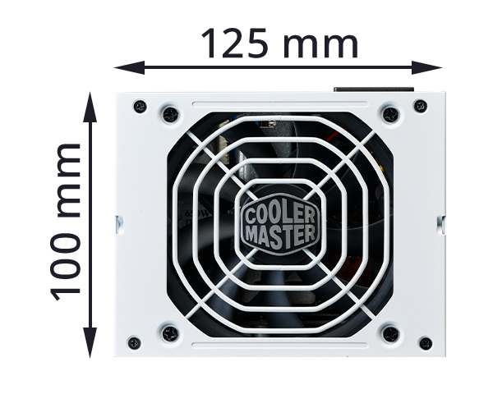
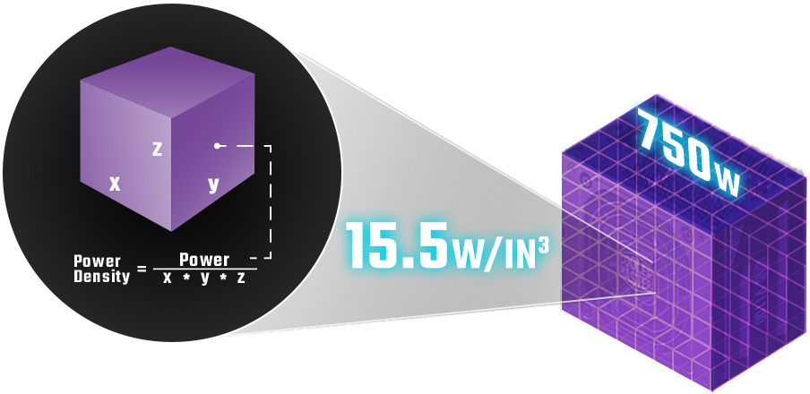
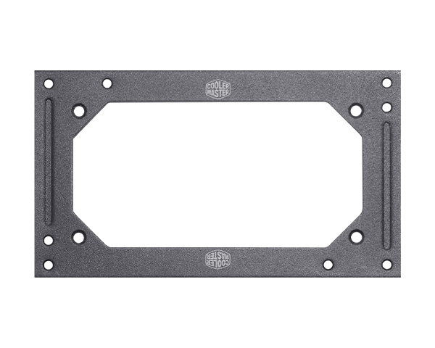
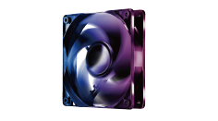
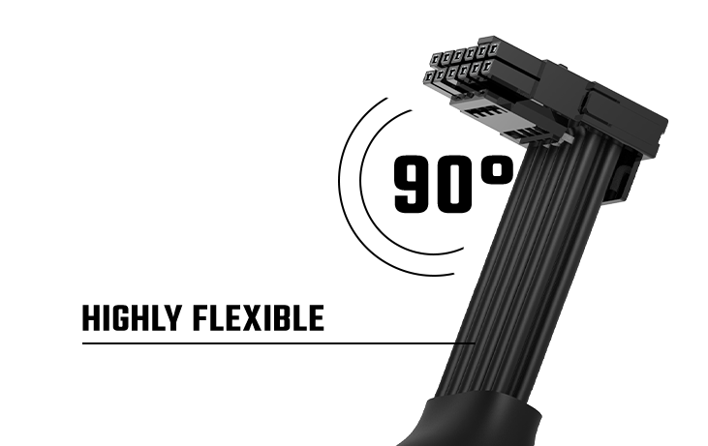
Compact SFX form factor
High power density​
he ultra-compact dimensions of this SFX unit make it the perfect fit for a mini-ITX build.
With 160% greater power density than the V Gold 750 V2, this is one of the highest power densities in the industry.
80 Plus Gold efficiency certification
Flexible compatibility
This unit is certified to achieve more than 90% efficiency at typical loads.
An included bracket ensures compatibility with both ITX and ATX cases.
Quiet FDB fan
A durable 12VHPWR cable
A fluid dynamic bearing fan delivers long-lasting quiet and effective cooling.
An advanced thermal structure and flexible cable provide improved safety.

Slide 3
Product Name​ |  | V SFX Gold 750 ATX 3.0 White Edition
Item Code​ |  | MPY-7501-SFHAGV
ATX Version​ |  | ATX3.0 & SFX 12V Ver. 3.42
PFC​ |  | Active PFC
Input Voltage​ |  | 100-240V
Input Current​ |  | 10-5A
Input Frequency​ |  | 50-60Hz
Dimensions (L x W x H)​ |  | 100 x 125 x 63.5mm
Fan Size​ |  | 92mm
Fan Bearing​ |  | FDB
Efficiency​ |  | 90% @ Typical Load
80 PLUS Rating​ |  | 80 PLUS Gold
ErP 2014 Lot 3​ |  | Yes
Operating Temperature​ |  | 0~50°C
Power Good Signal​ |  | 100-500ms
Hold Up Time​ |  | 16ms
MTBF​ |  | >100,000 hours
Protections​ |  | OVP / OPP / SCP / OCP / UVP / OTP / Surge and Inrush Protection
Regulatory​ |  | TUV, cTUVus, CE, BSMI, FCC, CCC, EAC, RCM, CB, UKCA
Connectors​ | ATX 24 Pin | x1 = 1x (300mm)
 | EPS 4+4 Pin | x1 = 1x (450mm)
 | EPS 8 Pin | x1 = 1x (450mm)
 | SATA | x8 = 2x (100+115+115+115mm)
 | Peripheral 4 Pin | x4 = 1x (100+115+115+115mm)
 | PCI-e 6+2 Pin | x4 = 2x (400+120mm)
 | 12VHPWR | x1 = 1x (400mm)
Package Content (Asscessories) | Cable bag | x1
 | Power cord | x1
 | Zip ties | x7
 | Velcro | x3
 | Screw bag​ | x1
 | ATX-ITX adapter bracket | x1
 | Manual – User Guide | x1
 | Cable Recommended Installation Guide | x1
AC INPUT | 100-240V~, 10–5A, 50 - 60Hz
DC OUTPUT | +3.3V | +5V | +12V | -12V | +5Vstb
 | 20A | 20A | 62.5A | 0.3A | 3A
TOTAL POWER | 120W |  | 750W | 3.6W | 15W
 | 750W

Slide 4
Cable Type | EAN | UPC
MPY-7501-SFHAGV-3WU A/US | 4719512134856 | 884102107177
MPY-7501-SFHAGV-3WK A/UK | 4719512134863 | 884102107184
MPY-7501-SFHAGV-3WE A/EU | 4719512134870 | 884102107191
MPY-7501-SFHAGV-3WS A/ST | 4719512134887 | 884102107207
MPY-7501-SFHAGV-3WA A/AU | 4719512134894 | 884102107214
MPY-7501-SFHAGV-3WB A/BR | 4719512134900 | 884102107221
MPY-7501-SFHAGV-3WY A/KR | 4719512134917 | 884102107238
MPY-7501-SFHAGV-3WT A/TW | 4719512134924 | 884102107245
MPY-7501-SFHAGV-3WJ A/JP | 4719512134931 | 884102107252
MPY-7501-SFHAGV-3WI A/IN | 4719512134948 | 884102107269
MPY-7501-SFHAGV-3WW A/WO | 4719512134955 | 884102107276
Net Weight | 1.42 kg
Gross Weight | 1.86 kg
Package Dimensions | 260 x 190 x 100mm (10.24 x 7.48 x 3.94")
Carton Dimensions | 520 x 275 x 215mm (20.47 x 10.83 x 8.46")
Unit / Carton | 5 pcs
Carton / Pallet | 24 pcs
All images and descriptions are solely for example purposes.
Specifications, features, and prices are subject to change without notice.
Specifications, appearances, and features may vary by model and region. Please refer to official specification pages for full details.
Unless otherwise stated, all performance claims are based on theoretical performance. Actual figures may vary in real-world situations.
Any configuration other than original product configuration is not performance guaranteed.

